Slide 1
Introduction to Xss and SQLi

Slide 2



Who dis?
Jess Kwek
DISM student at Singapore Polytechnic
Error 404: brain.exe not found
Find me at: pikachuuu1436@gmail.com
GitHub Blahblahlolhahaha
Koh Heng Woon
DISM Student Singapore Polytechnic
1 braincell and it’s for dogs
Find me at Github Wooniety
wooniety@gmail.com

Slide 3
Table of Contents
Before We Start
Why?
Setup
Cross-site Scripting
What is it?
Types of XSS
Things to note when protecting
SQL Injections

Slide 4
Before we start…
Sanity Check

Slide 5
Do you know this?
Basic Javascript
window.alert(“Hello World”)
Seen SQL commands
SELECT status FROM users WHERE user = ‘World’;
id | user | role | status
0 | heng | human | 1 braincell
1 | World | god | Hello
2 | Shad0w | human | I hear the voice of fate…
3 | jess | god | Error 404 ‘Mic.exe’ not found
Notes:
Robot test, if you can guess the output then it should be OK to follow

Slide 6
Check if these are downloaded
The github repo
https://github.com/Wooniety/Intro-to-XSS-and-SQL-with-Azure
NodeJS and npm
https://nodejs.org/en/download/
https://www.npmjs.com/get-npm (should come with NodeJS)
Code Editor
Notes:
Downloads!!

Slide 7
1.
Why?
No really, why?

Slide 8
Motivation
N/A
Notes:
N/A

Slide 9
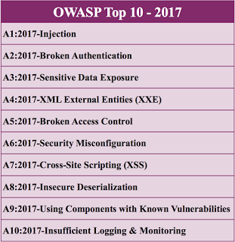
OWASP Top 10
Notes:
Fun fact:
The 2 things we’re going through is on OWASP top 10
The OWASP Top 10 is a standard awareness document for developers and web application security. It represents a broad consensus about the most critical security risks to web applications.

Slide 10
2.
Setup
AKA Welcome to the sad travel site
Notes:
Please don’t actually look through the code, we will properly implement the vulnerabilities in the next few days

Slide 11
Setup
Download the repo https://github.com/Wooniety/Intro-to-XSS-and-SQL-with-Azure.git
Open sed travels in IDE of your choice
Open a terminal and run npm install
Run node server.js to start it
Access http://localhost:3000 from browser

Slide 12
3.
Cross-site Scripting
XXS

Slide 13

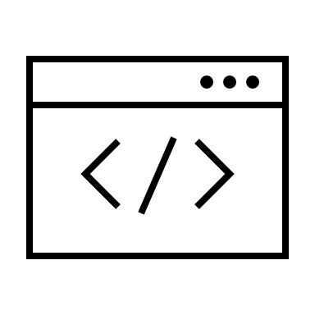
What is XSS?
Malicious code
Totally-not-sus
Website
This Photo by Unknown Author is licensed under CC BY-SA
Notes:
Involves malicious code in user provided data
E.g sus person includes some code in some data that is processed by the website
Can be in:
URLs
HTTP Headers
Form fields
XSS flaws occur whenever an application includes untrusted data in a new web page without proper validation or escaping, or updates an existing web page with user-supplied data using a browser API that can create HTML or JavaScript. XSS allows attackers to execute scripts in the victim’s browser which can hijack user sessions, deface web sites, or redirect the user to malicious sites.

Slide 14
Types of XSS
Reflected XSS
Stored XSS
DOM-Based XSS
THEY ALL DO THE SAME THING IN DIFFERENT WAYS

Slide 15
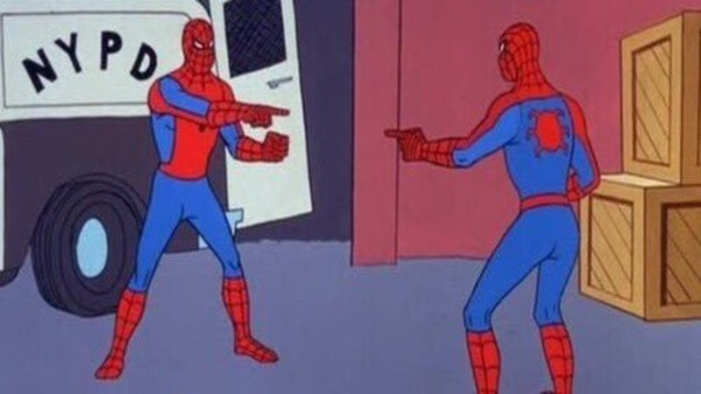
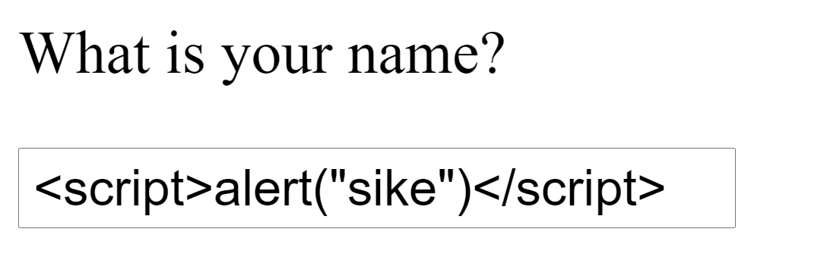
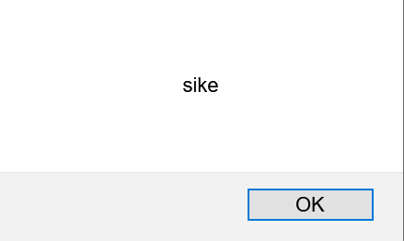
Reflected XSS
sike

Slide 16
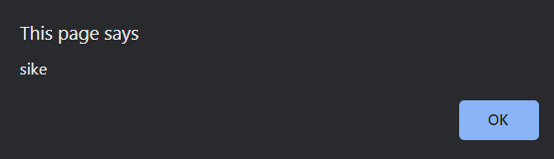
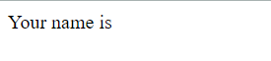
Reflected XSS
Receiving data in a HTTP request and including said data with an immediate response
Notes:
User sends page name
It’s a simple hello world program so the page prints the name
Sike, it’s an alert box

Slide 17


Stored XSS

Slide 18

Stored XSS (AKA Persistent XSS)
When unsafe data is saved and sent in later HTTP responses.
Notes:
This time, the name is stored in the database
Later when the user accesses a different page that pulls the data from the server, the page is sent back with the unsafe data

Slide 19

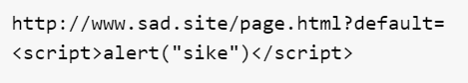
DOM Based XSS
Is this a URL?
Notes:
We ran out of meme ideas

Slide 20

DOM-based XSS
When client-side JS processes data and writes it to DOM
Notes:
Instead of being sent back and forth in HTTP requests, the data is processed on the client side through maybe Javascript and inserted back into the dom
E.g
<div id=“name”></div
<script>
$(“name”).html(<p>${name}</p>);
</script>

Slide 21
What can XSS be used for?
Read any data that the user is able to access.
Capture the user's login credentials.
Perform virtual defacement of the web site.
Inject trojan functionality into the web site.
This Photo by Unknown Author is licensed under CC BY-SA
Notes:
How creative can you get with XSS

Slide 22
Detecting XSS
Escaping
Sanitizing
Validating
Notes:
Explained more after SQL

Slide 23
4.
SQLI
Injections do be fun

Slide 24
SQL
Structured Query Language
Used to access and manipulate databases
Database
A place to store information
Normally stored in a series of tables within rows and columns
Notes:
Some examples of SQL databases include SQL server by Microsoft, MYSQL by Oracle, PostgresSQL and SQLite
SQL Statements:
SELECT/INSERT/UPDATE/DELETE
Other than SQL Databases another group of databases are also quite widely used by people. They are mainly called NoSQL databases as they do not use SQL to query for data
Some examples include MongoDB and Firebase

Slide 25
SQL Injections
An attack whereby an attacker places malicious SQL statements with malicious intentions
Normally done by sending requests to a backend server either by using an online form on the website or manually crafting a request and send
2 Types:
In band SQL injection
Blind SQL injection
Notes:
NoSQL databases can also be attacked too!
Normally attackers try to attack via permission issues or via an attack called NoSQL injection https://owasp.org/www-pdf-archive/GOD16-NOSQL.pdf

Slide 26
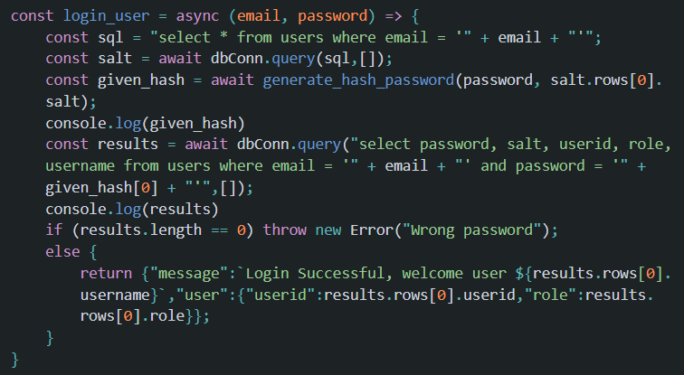
Code
Notes:
Basically email and password are being directly placed into the query without any sanitization

Slide 27
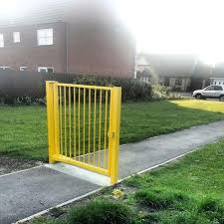
SQL Injections
Inputs are being placed into the SQL query without sanitizing or escaping
Makes it easy for attackers to inject SQL statements

Slide 28
SQL Injections
Attack:
Email = ' or 1=1; -- -
Password : anything
SQL statement becomes:
select password, salt, userid, role, username from users where email = '' or 1=1; -- - and password = '' + given_hash[0] + "'"

Slide 29
Try it yourself! ☺

Slide 30
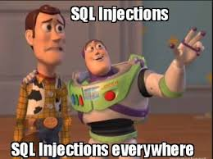
SQL Injections
Impacts
Unauthorized access and modifications to user/company information
Loss of data
Notes:
SQLI account for up to two thirds of the number of web application attacks between 2017 and 2019 and it has been at the top of the OWASP top 10 vuln for a long time

Slide 31
SQL Injections
Prevention
Escape all input properly!!!!!!!!!
If hosted on Cloud, can use web application firewall provided by the provider to prevent such attacks from reaching your backend server.
Notes:
Here are some useful libaries!
https://www.npmjs.com/package/validator

Slide 32
Thanks!
Any questions?

